Slide 1
Socket Programming - Client to Server Communication
By
Mahaveer

Slide 2
Introduction
Details about Socket
Java Socket programming is used for communication between the applications running on different JRE.
Java Socket programming can be connection-oriented or connection-less.
Socket and ServerSocket classes are used for connection-oriented socket programming and DatagramSocket and DatagramPacket classes are used for connection-less socket programming.
The client in socket programming must know two information:
IP Address of Server, and Port number.

Slide 3
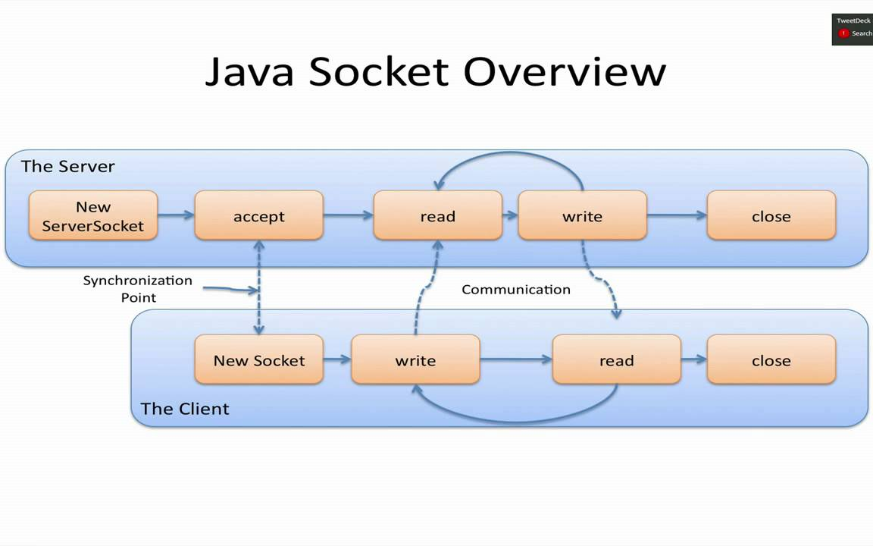
Overview

Slide 4
Client to Server Communication
Introduction
Before going into the details of client-to-server communication, it is advised to go through Networking Introduction and communication with TCP/IP protocol to know the terms and basics of networking and the way Java supports.
This is the first application in one-way communication. In one-way communication, here, client sends to server but server does not send back to client.

Slide 5
Program
Client to Server Communication
The application comprises of two program. A client program running on client-side and a server program running on server-side.
Refer this Links : https://way2java.com/networking/client-to-server-one-way-communication/
For Video : https://www.youtube.com/watch?v=c13XxZgUVj0&list=PLsyeobzWxl7qRzutQxZ9Xw7QJyr8Zuyif&index=2

Slide 6



Why do we use Socket programming?
A socket is one endpoint of a two-way communication link between two programs running on the network. A socket is bound to a port number so that the TCP layer can identify the application that data is destined to be sent to. An endpoint is a combination of an IP address and a port number.

Slide 7
How do sockets work?
A socket has a typical flow of events. In a connection-oriented client-to-server model, the socket on the server process waits for requests from a client. To do this, the server first establishes (binds) an address that clients can use to find the server.

Slide 8
What is ServerSocket? What is the use of accept () method?
ServerSocket is a class for creating a server side connection for remote clients to connect to, On client connection success, returns an ordinary socket which can later be used to communicate with the client. When the ServerSocket invokes accept(), the method does not return until a client connects.

Slide 9
How does the communication between sockets take place?
Socket Programming. Sockets provide the communication mechanism between two computers using TCP. A client program creates a socket on its end of the communication and attempts to connect that socket to a server. ... The server instantiates a ServerSocket object, denoting which port number communication is to occur on.

Slide 10
Thank You

